Slide 1
Perceived “Resource Dependence” and Canadian Public Universities
(My Attempt at) Building a Fine Tuned Classifier LLM
Sara Murphy, Computational Text Analysis, April 13, 2026

Slide 2
Overview
Goal:
Detect presence of “resource dependence” language
Detect intensity of “resource dependence” language – low vs high
Methods:
Built Fine Tuned Classifer LLM (0,1) – perceived resource dependence (no or yes)
Built Fine Tuned Classifer LLM (0,1) – intensity of perceived resource dependence (low or high)
Future Application:
Relationship between perceived resource dependence and financial performance (presence, intensity)
Predict financial performance in provinces outside Ontario (e.g. Nova Scotia)
Link perceived resource dependence to leadership background and frequency of change
Challenges/Limitations:
Sample size
Variation in documents across universities
Conceptual ambiguity and human validation
Moving to application stage

Slide 3
Context:
Public Universities in Ontario (Post 2019)

Slide 4

($63 million)
-9%
“Queen’s could cease to exist”
Notes:
Coppolino, S. (2024, January 9). “Queen’s could cease to exist if we don’t deal with this issue:” faculty and staff remain skeptical. The Queen’s Journal. https://www.queensjournal.ca/queens-university-faces-imminent-closure-if-cuts-not-made-faculty-and-staff-remain-skeptical/
`

Slide 5




1/2
(~$300M)
(~$600M)
Notes:
https://www.therecord.com/news/waterloo-region/university-of-waterloo-sees-75m-deficit-ahead-proposes-hiring-limit/article_25a1bf10-0f48-5489-9d56-0524fda12dd6.html
https://ontariosuniversities.ca/news/cou-statement-ontarios-universities-call-for-support-in-upcoming-fall-economic-statement/
Ontario Universities. Get to Know Ontario’s Universities – OUInfo. Ouinfo.ca. https://www.ouinfo.ca/universities
CTV News Toronto. (2024, February 26). Ontario freezes post-secondary tuition for 3 more years, adds $1.3B in funding [Review of Ontario freezes post-secondary tuition for 3 more years, adds $1.3B in funding]. CTV News Toronto; CTV News. https://toronto.ctvnews.ca/ontario-freezes-post-secondary-tuition-for-3-more-years-adds-1-3b-in-funding-1.6783368
U of T. Budget Report 2023-2024. Planning & Budget Office, 2023.
Western University: 2024-2025 Operating and Capital Budgets [Review of Western University: 2024-2025 Operating and Capital Budgets]. Western University. https://www.ipb.uwo.ca/documents/2024_budget.pdf
McMaster University. 2024-2025 Consolidated Budget. Board of Governors , 2024.

Slide 6



Slide 7


Construct:
Resource Dependence

Slide 8
Resource Dependence
Power & Resource Dependence, Emerson (1962)
“Power is the inverse of Dependence in an A-B Relationship”
“Dependence = motivational investment in the same goals/rewards, inverse of availability of alternative means of achieving goals outside of the relationship”
Resource Dependence is not an objective concept
Yet typically studied in concrete terms (finances, resource flows)
There is a subjective, perceived or performative reality
No dictionaries or LLMs assess perceptions of RD via text analysis

Slide 9
Research Questions:
What a Fine-Tuned Classifier Could Help Answer

Slide 10
Research Questions
1) How does perceived resource dependence moderate the financial performance impact of the 2019 policy shock?
2) How does perceived resource dependence change in response to the 2019 policy shock ?
3) How does leadership succession cause change in perceived resource dependence pre and post the 2019 policy shock?

Slide 11
Data Collection, Processing & Sampling

Slide 12
Data: Original Plan
Operating Budgets
Ontario x 20 universities
British Columbia & Nova Scotia X 18 universities
2014-2025
Unit of Analysis
Introduction Section
“Setting the Context”, “Introduction”, “Executive Summary”, “Changing Financial Landscape”
1-5 pages of document
Paragraph Level
5 – 45 paragraphs per introduction section
Size of Total Corpus
38 universities X 12 years X 12 paragraphs = 5,472 paragraphs

Slide 13
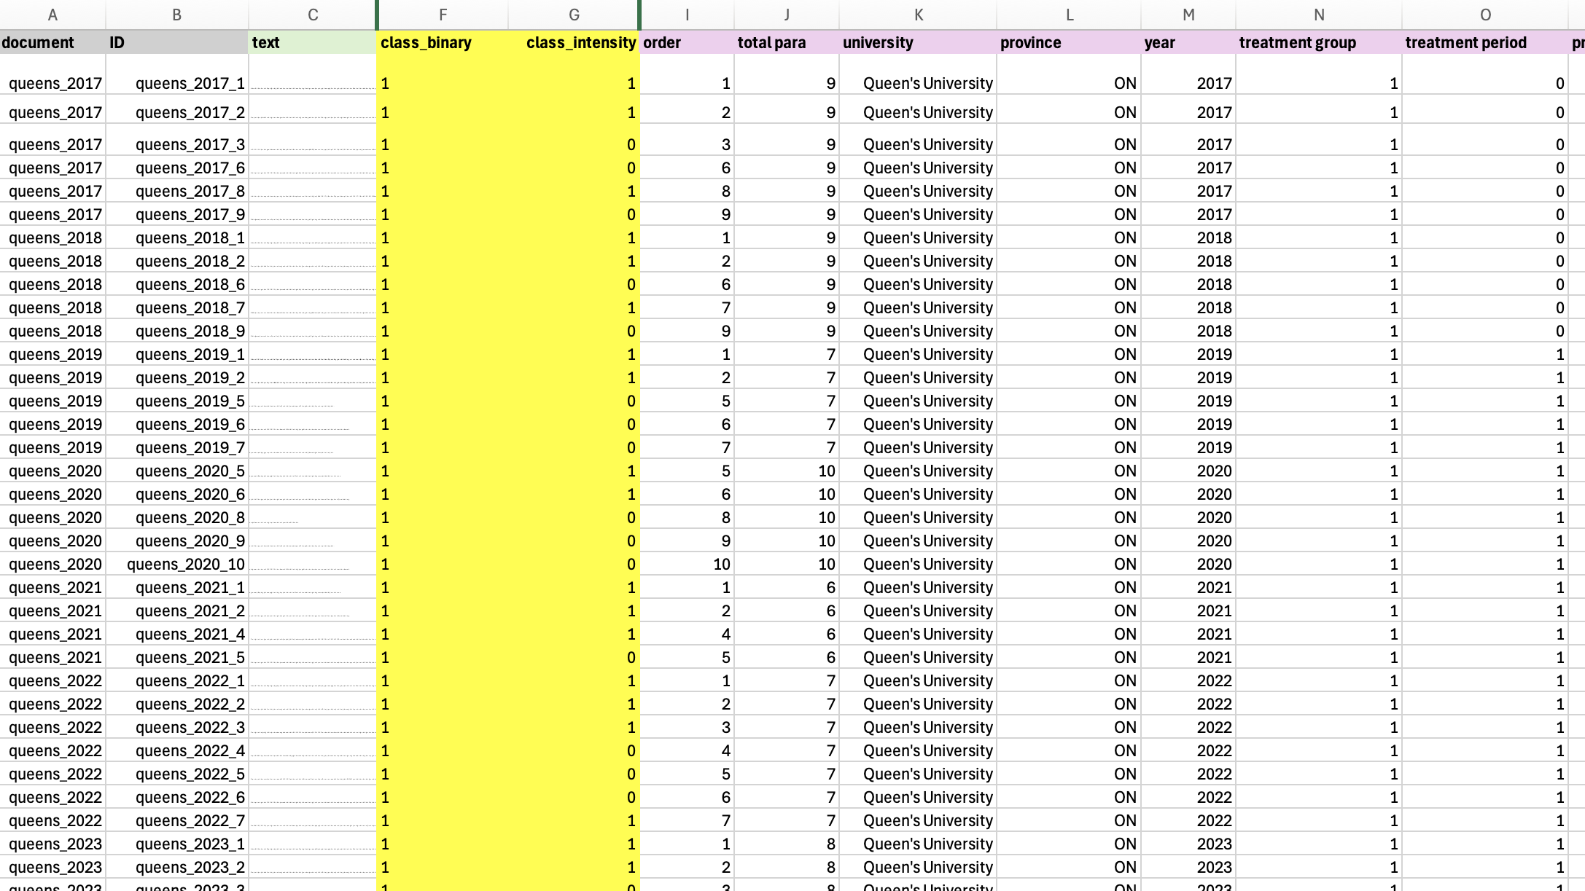
Building My Corpora

Slide 14
Variables & LLM Annotating: Fine Tuner (1)
Class_Binary
0 = No Perceived Resource Dependence
1 = Perceived Resource Dependence
Codebook
LLM Intercoder Reliability

Slide 15
Variables & LLM Annotating: Fine Tuner (2)
Class_Intensity
0 = Low Perceived Resource Dependence
1 = High Perceived Resource Dependence
Codebook
LLM Intercoder Reliability

Slide 16
Binary Classifier (Perceived RD)
Binary Classifier (Perceived RD Intensity)
Phase 1
Phase 2
Phase 3
Queen’s University
2017-2025
University of Toronto
2017-2025
Total observations:
327
Class 0 – No = 184
Class 1 – Yes = 143
Queen’s University
University of Toronto
Carleton University
University of Windsor
York University
Nipissing University
Lakehead University
Wilfrid Laurier University
University of Waterloo
Western University
McMaster University
Various Years
Post 2019
Total observations:
337
Class 0 – Low = 214
Class 1 – High = 123
Queen’s University
University of Toronto
Carleton University
University of Windsor
Various Years
Post 2019
Total observations:
236
Class 0 – Low = 154
Class 1 – High = 82
Add Sample
Phase 4
Total observations:
644
Class 0 – No = 307
Class 1 – Yes = 337
Revise Codes
Add Sample

Slide 17
Binary Classifier (Perceived RD)
Phase 1
V14. xlsx
Stratified K Fold
No Class Weight Loss
No Weighted Sampling

Slide 18
Binary Classifier (Perceived RD)
Phase 1
 | fold | Train Loss | Val Loss | Accuracy | Weighted F1 | F1_0 | F1_1
0 | 1 | 0.698057 | 0.671035 | 0.560606 | 0.402766 | 0.000000 | 0.718447
1 | 1 | 0.664254 | 0.677310 | 0.560606 | 0.402766 | 0.000000 | 0.718447
2 | 1 | 0.568641 | 0.619747 | 0.636364 | 0.566919 | 0.333333 | 0.750000
3 | 1 | 0.505898 | 0.623363 | 0.681818 | 0.659631 | 0.533333 | 0.758621
4 | 2 | 0.689950 | 0.684404 | 0.560606 | 0.402766 | 0.000000 | 0.718447
5 | 2 | 0.681073 | 0.624862 | 0.590909 | 0.467437 | 0.129032 | 0.732673
6 | 2 | 0.547687 | 0.453209 | 0.757576 | 0.752681 | 0.692308 | 0.800000
7 | 2 | 0.396852 | 0.373532 | 0.772727 | 0.770956 | 0.727273 | 0.805195
8 | 3 | 0.685684 | 0.656347 | 0.569231 | 0.412971 | 0.000000 | 0.725490
9 | 3 | 0.671715 | 0.705432 | 0.569231 | 0.412971 | 0.000000 | 0.725490
10 | 3 | 0.621074 | 0.501803 | 0.738462 | 0.739704 | 0.721311 | 0.753623
11 | 3 | 0.491929 | 0.503208 | 0.784615 | 0.785641 | 0.766667 | 0.800000
12 | 4 | 0.705507 | 0.691357 | 0.569231 | 0.412971 | 0.000000 | 0.725490
13 | 4 | 0.679103 | 0.684476 | 0.569231 | 0.412971 | 0.000000 | 0.725490
14 | 4 | 0.585710 | 0.534585 | 0.707692 | 0.708254 | 0.666667 | 0.739726
15 | 4 | 0.438606 | 0.541963 | 0.707692 | 0.708662 | 0.698413 | 0.716418
16 | 5 | 0.702770 | 0.664352 | 0.553846 | 0.394821 | 0.000000 | 0.712871
17 | 5 | 0.666267 | 0.721653 | 0.553846 | 0.394821 | 0.000000 | 0.712871
18 | 5 | 0.614998 | 0.544134 | 0.584615 | 0.480802 | 0.181818 | 0.721649
19 | 5 | 0.532960 | 0.568837 | 0.692308 | 0.668401 | 0.545455 | 0.767442

Slide 19
Binary Classifier (Perceived RD Intensity)
Phase 2
V18. xlsx
“Model performance varies substantially across folds, with F1 scores for dependence ranging from 0.00 to 0.84. This instability reflects the heterogeneity and contextual nature of dependence language, which is not uniformly distributed across training samples.”
Stratified K Fold
Class Weight Loss
No Weighted Sampling

Slide 20
Binary Classifier (Perceived RD)
Phase 2
 | fold | Train Loss | Val Loss | Accuracy | Weighted F1 | F1_0 | F1_1
0 | 1 | 0.698116 | 0.692005 | 0.645833 | 0.506857 | 0.784810 | 0.000000
1 | 1 | 0.693579 | 0.680626 | 0.729167 | 0.734649 | 0.771930 | 0.666667
2 | 1 | 0.658137 | 0.648379 | 0.750000 | 0.734244 | 0.823529 | 0.571429
3 | 1 | 0.614589 | 0.611516 | 0.770833 | 0.769180 | 0.825397 | 0.666667
4 | 2 | 0.693276 | 0.690623 | 0.531915 | 0.498542 | 0.450000 | 0.592593
5 | 2 | 0.695861 | 0.685286 | 0.659574 | 0.524277 | 0.794872 | 0.000000
6 | 2 | 0.662835 | 0.669772 | 0.659574 | 0.524277 | 0.794872 | 0.000000
7 | 2 | 0.618959 | 0.655516 | 0.680851 | 0.571136 | 0.805195 | 0.117647
8 | 3 | 0.691353 | 0.686383 | 0.659574 | 0.657108 | 0.652174 | 0.666667
9 | 3 | 0.672812 | 0.658346 | 0.851064 | 0.854595 | 0.877193 | 0.810811
10 | 3 | 0.656609 | 0.562649 | 0.851064 | 0.854595 | 0.877193 | 0.810811
11 | 3 | 0.556855 | 0.457815 | 0.851064 | 0.854595 | 0.877193 | 0.810811
12 | 4 | 0.696751 | 0.688629 | 0.659574 | 0.524277 | 0.794872 | 0.000000
13 | 4 | 0.688263 | 0.676231 | 0.595745 | 0.589511 | 0.577778 | 0.612245
14 | 4 | 0.668917 | 0.638787 | 0.893617 | 0.892745 | 0.920635 | 0.838710
15 | 4 | 0.615458 | 0.585379 | 0.851064 | 0.846797 | 0.892308 | 0.758621
16 | 5 | 0.696382 | 0.689614 | 0.361702 | 0.192154 | 0.000000 | 0.531250
17 | 5 | 0.697424 | 0.685593 | 0.638298 | 0.497375 | 0.779221 | 0.000000
18 | 5 | 0.668353 | 0.655760 | 0.680851 | 0.586786 | 0.800000 | 0.210526
19 | 5 | 0.622997 | 0.626733 | 0.659574 | 0.572628 | 0.783784 | 0.200000

Slide 21
Binary Classifier (Perceived RD Intensity)
Phase 3
V23. xlsx
“Expanding the labeled dataset substantially improved model performance, enabling the classifier to reliably distinguish between low and high resource dependence. While early training epochs exhibited instability, later epochs produced consistent and balanced classification performance across folds, with F1 scores exceeding 0.70 for both classes.”
“The model demonstrates predictive capability, but performance variability across folds suggests sensitivity to training data composition.”
“The model achieved moderate predictive performance (Mean F1 = 0.59), with balanced classification across both classes. However, relatively high variance across cross-validation folds indicates sensitivity to training sample composition, likely reflecting both limited sample size and the conceptual ambiguity inherent in coding resource dependence in textual data.”
Stratified K Fold
No Class Weight Loss
Weighted Sampling

Slide 22
Binary Classifier (Perceived RD Intensity)
Phase 3
 | fold | Train Loss | Val Loss | Accuracy | Weighted F1 | F1_0 | F1_1
0 | 1 | 0.696740 | 0.685739 | 0.632353 | 0.489931 | 0.774775 | 0.000000
1 | 1 | 0.677979 | 0.692894 | 0.367647 | 0.197660 | 0.000000 | 0.537634
2 | 1 | 0.627203 | 0.556448 | 0.735294 | 0.739938 | 0.763158 | 0.700000
3 | 1 | 0.419074 | 0.470369 | 0.735294 | 0.738642 | 0.780488 | 0.666667
4 | 2 | 0.694548 | 0.704199 | 0.367647 | 0.197660 | 0.000000 | 0.537634
5 | 2 | 0.684775 | 0.667640 | 0.705882 | 0.635590 | 0.811321 | 0.333333
6 | 2 | 0.684862 | 0.626919 | 0.779412 | 0.755143 | 0.848485 | 0.594595
7 | 2 | 0.608624 | 0.591515 | 0.808824 | 0.810779 | 0.843373 | 0.754717
8 | 3 | 0.697393 | 0.700866 | 0.373134 | 0.220217 | 0.045455 | 0.533333
9 | 3 | 0.685998 | 0.675704 | 0.701493 | 0.703909 | 0.761905 | 0.600000
10 | 3 | 0.574339 | 0.598587 | 0.835821 | 0.830786 | 0.879121 | 0.744186
11 | 3 | 0.425907 | 0.600454 | 0.761194 | 0.763127 | 0.809524 | 0.680000
12 | 4 | 0.696004 | 0.693863 | 0.417910 | 0.306874 | 0.170213 | 0.551724
13 | 4 | 0.673409 | 0.624674 | 0.701493 | 0.660931 | 0.800000 | 0.411765
14 | 4 | 0.589471 | 0.443287 | 0.776119 | 0.775024 | 0.827586 | 0.680851
15 | 4 | 0.411673 | 0.394154 | 0.820896 | 0.816735 | 0.866667 | 0.727273
16 | 5 | 0.705958 | 0.705578 | 0.373134 | 0.202790 | 0.000000 | 0.543478
17 | 5 | 0.702980 | 0.683265 | 0.582090 | 0.580413 | 0.575758 | 0.588235
18 | 5 | 0.640220 | 0.578193 | 0.641791 | 0.556831 | 0.769231 | 0.200000
19 | 5 | 0.558276 | 0.522041 | 0.776119 | 0.776966 | 0.819277 | 0.705882

Slide 23
Binary Classifier (Perceived RD)
Phase 4
V24. xlsx
Stratified K Fold
No Class Weight Loss
No Weighted Sampling

Slide 24
Binary Classifier (Perceived RD Intensity)
Phase 4

Slide 25
Binary Classifier (Perceived RD)
Binary Classifier (Perceived RD Intensity)
Phase 1
Phase 2
Phase 3
Mean ACC | SD ACC | Mean Weighted FI
0.636 | 0.08 | 0.548
Mean ACC | SD ACC | Mean Weighted FI
0.699 | 0.124 | 0.639
Mean ACC | SD ACC | Mean Weighted FI
0.645 | 0.165 | 0.588
Phase 4
Mean ACC | SD ACC | Mean Weighted FI

Slide 26
Challenges & Adjustments
Issues:
Folds collapsing to one category (Low Mean Weighted F1, Mean F1, Mean F0)
Sample Size
Weak Signal
Time consuming to build Class 1 (High PRD)
Re-classifying codes regularly in earlier stages
Changes:
Class Weighted Loss
Weighted Sampling within Folds
Stratified K Fold
Epoch = 4
Learning Rate

Slide 27
Future Applications and Next Steps

Slide 28
Main Takeaways

